Slide 1



Performers’ rights
Copyright in the Digital Environment
Amy Thomas
25 February 2026

Slide 2
Format: 25 February
Performers’ rights: subsistence, ownership, and economic and moral rights
Lookalikes, soundalikes and deepfakes
Will try to reserve ~ 10 mins for any convenor questions at the end of class

Slide 3
Performers’ rights
Often conceptualised as a ‘neighbouring’ or ‘related’ right (to copyright), because of reliance on underlying work (but we will see this is not always the case)
Performances need to meet the following criteria to be protected under the CDPA (Chapter II):
(1) It is a ‘qualifying performance’, and;
(2) It is made by a qualifying individual(s) in a qualified country.
If they meet this criteria, they will receive automatic protection
Some Collective Management Organisations (CMOs) – like PRS – may require registration (a ‘bonus’, but not mandatory) – n.b., no concept of ‘joint’ performer-ship

Slide 4
Performers’ rights
What is a qualifying performance?
(1) the qualifying performance must fit into one of the four categories in CDPA s180(2), and;
(2) it is a live performance, or;
(3) it is a recording of a performance.

Slide 5
Performers’ rights: the four categories
CDPA s180(2)
Performance category | Definition of underlying work (explicit or implied)* | Examples
Dramatic performance | … includes a work of dance or mime. | [in addition to dance and mime] Theatre
Musical performance | … consists of music, exclusive of any words or action intended to be sung, spoken or performed with the music. | Playing an instrument to create melody, rhythm, baseline
Reading or recitation of literary work | … is written, spoken or sung. | Scripted film and TV acting, voice acting
Variety acts or any similar presentation | - | Any other act for entertainment purposes, such as magicians, clowns, jugglers, acrobats

Slide 6
Performers’ rights: live performances
Normative aim: to protect against unauthorised recording of real time, in-person performances – e.g., recording a gig, stand-up show,
Doesn’t need to be performed in front of a ‘live’ audience (Bamgboye v Reed) e.g. releasing an unauthorised ‘deleted scene’ filmed on set (Shelley Films v Rex Features)

Slide 7
Performers’ rights: recorded performances
Recorded performances are performances which are fixed in a film and/or sound recording
Those films and sound recordings may be made directly from the live performance, the broadcast of a performance, or made (directly or indirectly) from another recording of the performance

Slide 8

Performers’ rights: subsistence
(1) the qualifying performance must fit into one of the four categories in CDPA s180(2), and;
(2) it is a live performance, or;
(3) it is a recording of a performance.
https://forms.office.com/e/1XHpm1C5yJ

Slide 9
Rights granted
Rights given to performers are patchy and depend on the type of performance
 | Contractable? | Live performers | Performers on sound recordings | Audiovisual performers
Economic rights | Assignable/licensable | Recording, copying and broadcasting | Recording, copying and broadcasting + Making available to the public and public performance | Recording and copying
Moral rights | Waivable | Yes | Yes | -
Remuneration rights | Unwaivable | - | Yes | -

Slide 10
The equitable remuneration right
182D CDPA implementing the Rome Convention and (EU) Rental Directive:
(1)Where a commercially published sound recording of the whole or any substantial part of a qualifying performance—
(a) is played in public, or
(b) is communicated to the public […]
the performer is entitled to equitable remuneration from the owner of the copyright in the sound recording
(2)The right to equitable remuneration under this section may not be assigned by the performer except to a collecting society [usually Performing Rights Society (PRS) and Phonographic Performance Limited (PPL)] for the purpose of enabling it to enforce the right on his behalf.

Slide 11
The equitable remuneration right
Typically, the equitable remuneration right would mandate a 50/50 share between copyright holders and all performers, including session artists. But -
When songs are streamed this does not trigger the right of equitable remuneration. Why not?

Slide 12
10%
(5% each between performers and composers, usually excluding session artists)
Artists (including lyricists, singers, musicians, composers and session artists)
Our subscription fees and/or ad-revenue
Pro-rata models (%’s of aggregate streams)
Publishers (exploiting the underlying lyrics, melody and performers’ rights)
10%
50%
Record label (exploiting the sound recording itself)
30%
The platform (distributing the song)

Slide 13
The equitable remuneration right
If equitable remuneration triggers a responsibility to the record label, then it would be in their interest for music streaming not to be a ‘communication to the public’!
Sony, Universal and Warner make up more than 50% of the record label market <- leveraging market power to strike favourable deals
Remember (allegedly): Record Industry Association of America left advanced negotiations with Napster in the 1990s when asked to disclose how monies are allocated between themselves and artists

Slide 14
70%
(between performers and composers)
Artists (including lyricists, singers, musicians, composers and session artists)
Our subscription fees and/or ad-revenue
Pro-rata models (%’s of aggregate streams)
Publishers (exploiting the underlying lyrics, melody and performers’ rights)
Record label (exploiting the sound recording itself)
30%
The platform (distributing the song)

Slide 15
Platform policies
The benefits of the ‘democratisation’ of content production vs:
Disintermediation (losing the ‘middle man’): lack of human curation and outsourcing to the algorithm – money is dependent on discoverability
Is the algorithm a ‘neutral’ or ‘personal’ recommendation?
‘Payola’: undisclosed payment or other benefits when a commercial broadcaster is paid to play a song (The Broadcasting Act 1990 – a form of bribery)
Spotify’s ‘Discovery Mode’ allows artists to accept a lower per-stream rate to have favourable algorithm coverage
See: US lawsuit

Slide 16
Platform policies
Spotify have proposed a policy change that songs will need a minimum of 1000 streams within the preceding 12 months to be eligible for royalties
Spotify’s average rate is $0.004 per stream
1,000 streams × $0.004/stream = $4.00
Do you support this policy change? Why/why not?

Slide 17
Legislative change
Proposed Copyright (Rights and Remuneration of Musicians etc) Bill
Streaming = communication to the public = equitable remuneration
Transparency obligations: mandatory reporting on earnings and distribution
Ability to renegotiate contracts (a ‘reversion’ right) (note: we currently have a version of this for music artists, but it’s very useless - CDPA 191HA)
Improve metadata practices and royalty-chain tracing
Incentivise platforms that host user generated content (like YouTube) enter into licensing agreements
Voluntary methods, e.g., change from pro-rata streaming allocations to a ‘user-centric’ model, like Deezer/Soundcloud
Ultimately the bill was rejected because the market is ‘operating’ (music is affordable, people can create freely)
But this is not the same as social justice! (will return to this in our contracts/earnings class)

Slide 18
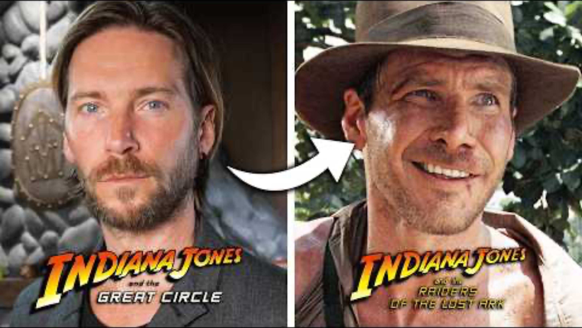
Lookalikes and soundalikes
Harrison Ford is the famous actor who portrayed Indiana Jones in a series of Hollywood films. Recently, Indiana Jones and the Great Circle was released, a video game where Indiana Jones is portrayed by Troy Baker. Is this an infringement of Harrison Ford’s performers’ rights? Assume it’s all made in the UK!

Slide 19
Lookalikes and soundalikes
But – in the AI context - audiovisual performers do have fewer rights than other performers – the UK has yet to ratify the Beijing Treaty on Audiovisual Performances
 | Contractable? | Live performers | Performers on sound recordings | Audiovisual performers
Economic rights | Assignable/licensable | Recording, copying and broadcasting | Recording, copying and broadcasting + Making available to the public and public performance | Recording and copying
Moral rights | Waivable | Yes | Yes | -
Remuneration rights | Unwaivable | - | Yes | -

Slide 20
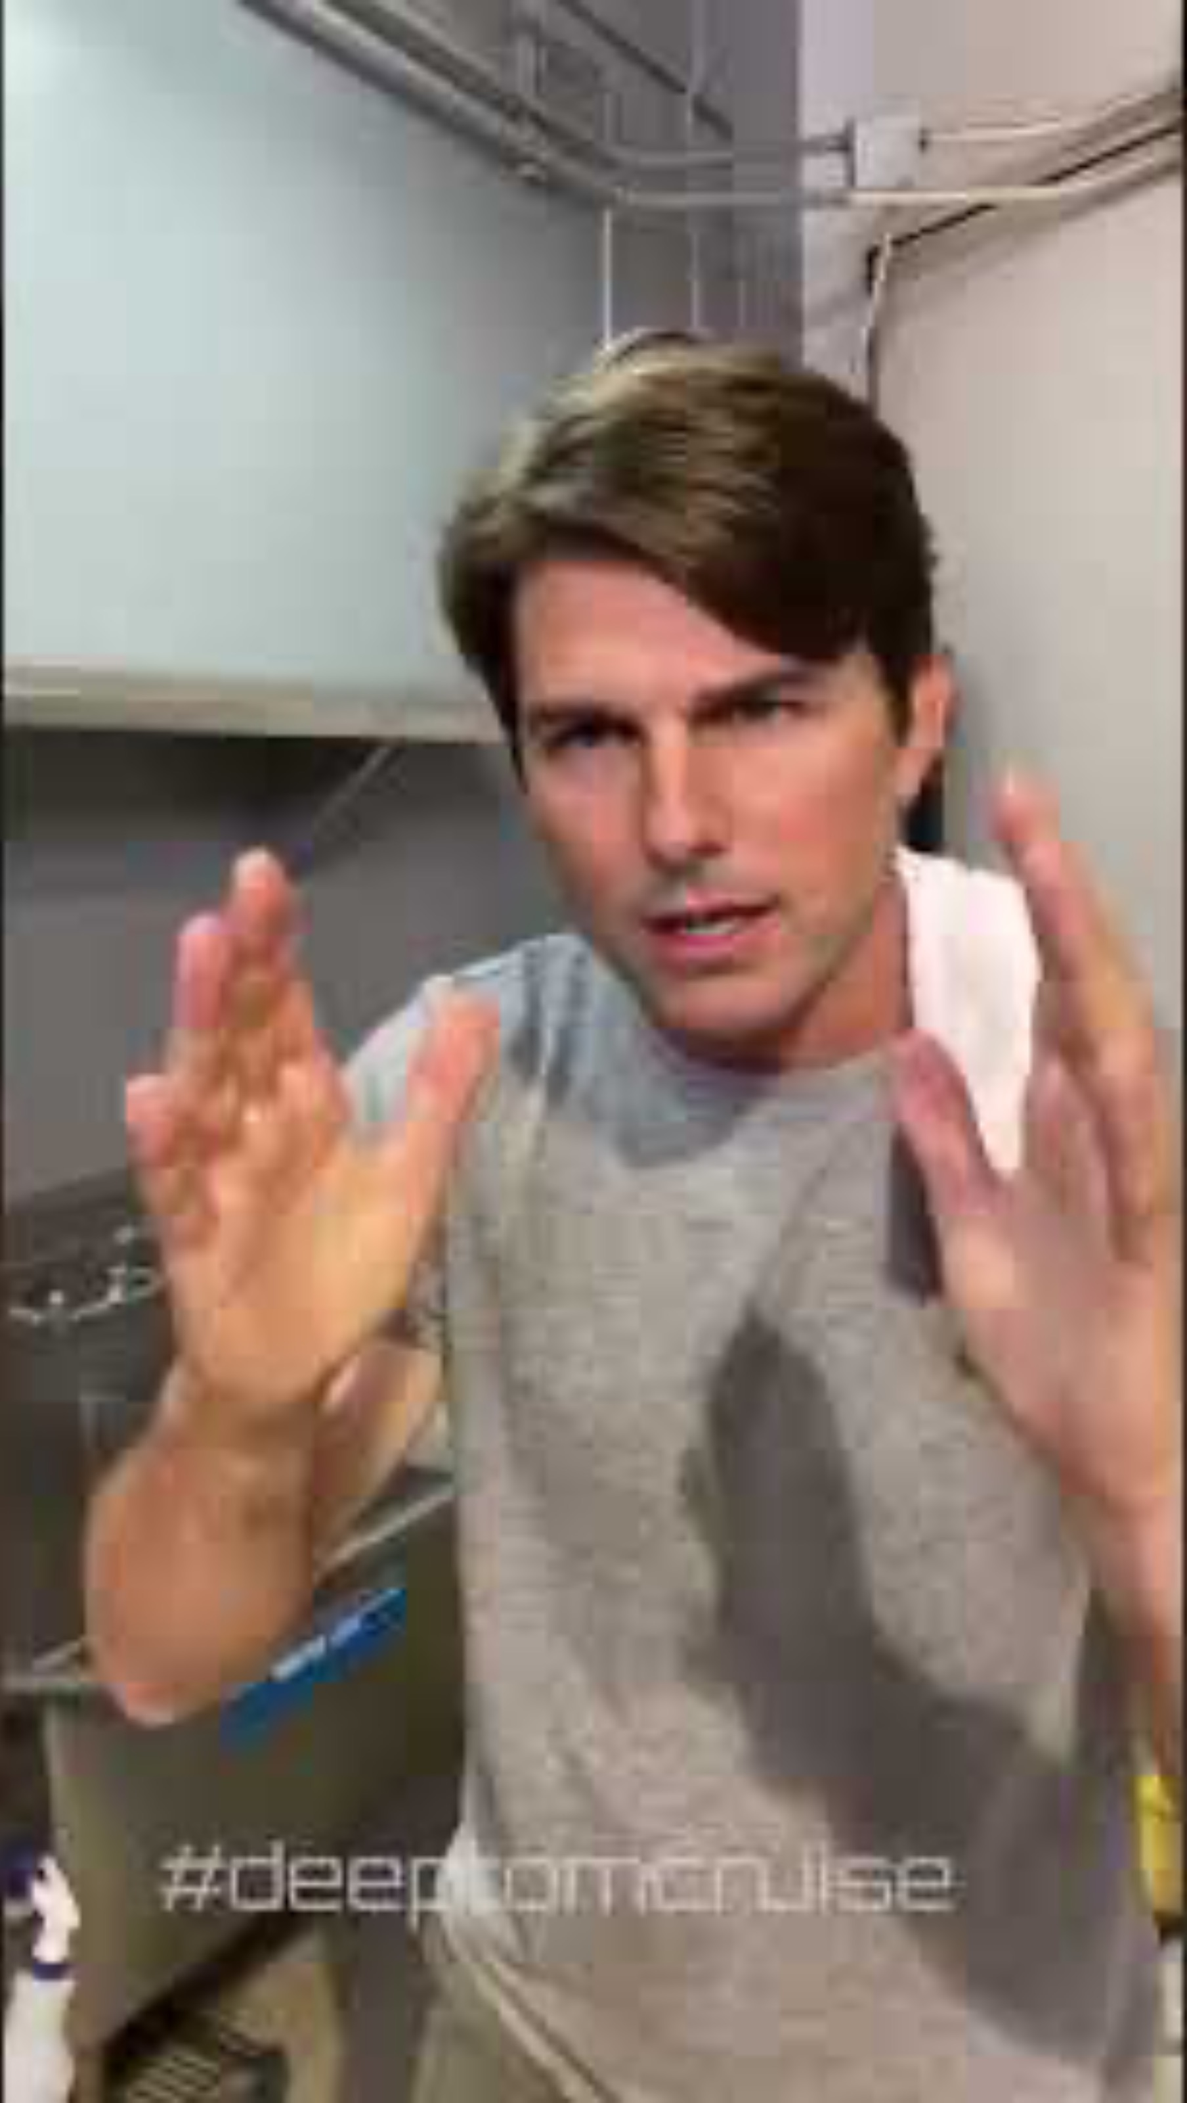
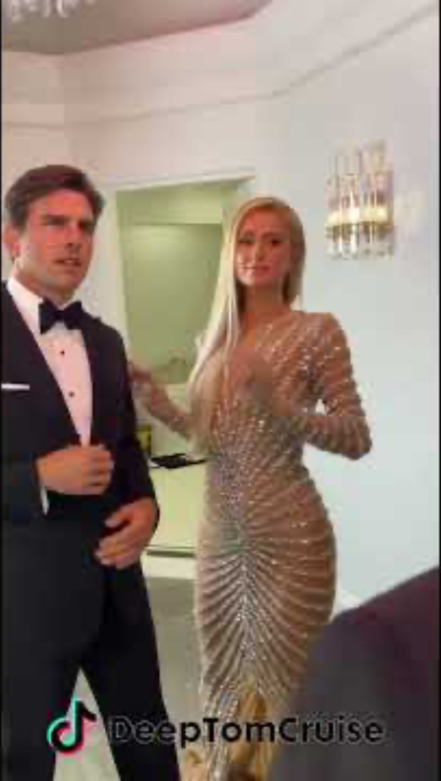
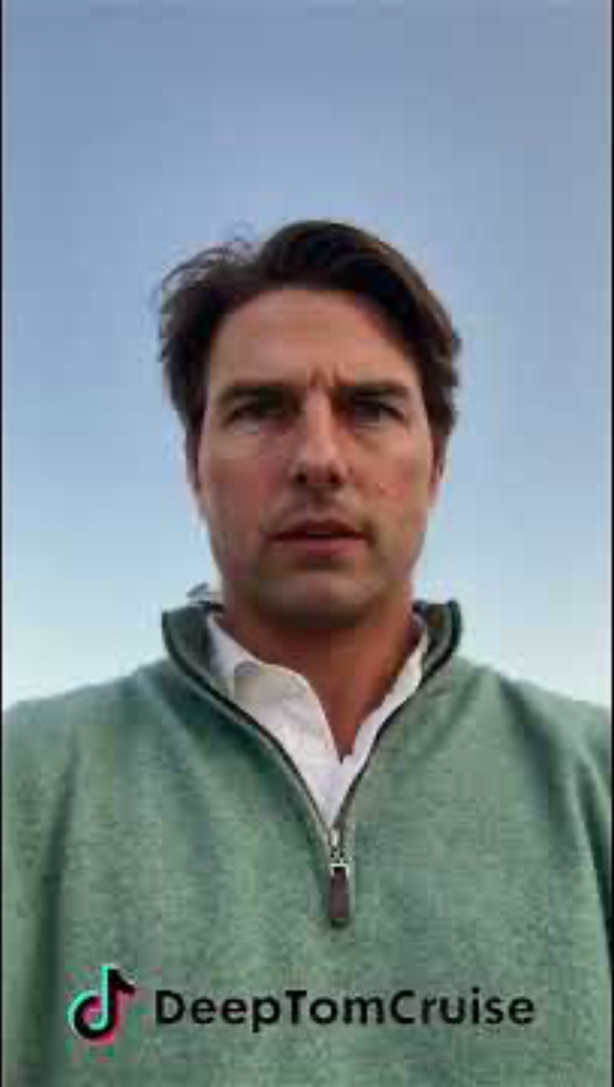
Deepfakes
'Deepfakes’ – using AI making to make it look like someone did/said something that they didn’t

Slide 21

Deepfakes
Assume Tom Cruise is a UK-based actor and these deepfakes were made in the UK. Can Tom Cruise rely on his performers' rights to stop these videos?
https://forms.office.com/e/aYr5N2PLJG

Slide 22
Performers’ rights – a summary for your AI classes!
Performers’ have more limited rights than ‘authors’ in copyright, especially audiovisual performers
Performers may face particular vulnerabilities where their performances are used to train AI models, because there is little legal protection for ‘likenesses’ in the UK
Things you might want to ask our guest lecturers…
Are there ‘copies’ of performances in AI models?
Can an AI be a ‘performer’?

Slide 23
Next week…
Seminar 7: (with Martin Kretschmer) AI: Inputs and Licensing Economy
Seminar 8: (with Kris Erickson) AI: Outputs and Creativity
Remember: you can ask guest lecturers subject-specific/class specific questions, but questions about assignments etc. should be sent to me (amy.thomas@glasgow.ac.uk)

